Slide 1
E Commerce Recommendation System
By - Osama Khan

Slide 2
Background of Project
E-commerce companies like Amazon, and Flipkart uses different recommendation systems to provide suggestions to customers. Amazon uses currently item-item collaborative filtering, which scales to massive datasets and produces high-quality recommendation systems in real time. This system is a kind of information filtering system which seeks to predict the "rating" or preferences that the user is interested in.
What recommended system can solve this?
It can help the user to find the right product.
It can increase user engagement. For example, there are 40% more clicks on google news due to recommendations.
It helps the item providers to deliver the items to the right user. On Amazon, 35 % of products get sold due to recommendations.
It helps to make the content more personalized. On Netflix, most of the rented movies are from recommendations.

Slide 3
Recommendation System and Its Type
In this modern world, we are overloaded with data and this data provides us with useful information. But it's not possible for the user to extract the information which interests them from these data. In order to help the user to find out information about the product, recommendation systems were developed. The recommender system creates a similarity between the user and items and exploits the similarity between the user/item to make recommendations.
There are mainly 6 types of recommendations systems:
Popularity-based recommender system
Collaborative recommender system,
Content-based recommender system,
Demographic-based recommender system,
Utility-based recommender system,
Hybrid recommender system.

Slide 4





Technology Used

Slide 5
Recommender System In Project
I have build two types of recommendation system in the project using the e commerce dataset.
Popularity-Based Recommendation System:
It is a type of recommendation system which works on the principle of popularity and or anything which is in trend. These systems check about the product or movie which are in trend or are most popular among the users and directly recommend those.
Collaborative-Based Recommendation System:
Collaborative filtering needs a set of items that are based on the user’s historical choices. This system does not require a good amount of product features to work. An embedding or feature vector describes each item and User, and it sinks both the items and the users in a similar embedding location. It creates enclosures for items and users on its own.
There are two types of the collaborative filtering process:
Memory-based collaborative filtering
Model-based collaborative filtering

Slide 6
Algorithms In Recommender System
I have used two types of algorithms in the collaborative recommendation system in the project.
SVD - Singular Value Decomposition:
The Singular Value Decomposition (SVD), a method from linear algebra that has been generally used as a dimensionality reduction technique in machine learning. SVD is a matrix factorisation technique, which reduces the number of features of a dataset by reducing the space dimension from N-dimension to K-dimension (where K<N). In the context of the recommender system, the SVD is used as a collaborative filtering technique. It uses a matrix structure where each row represents a user, and each column represents an item. The elements of this matrix are the ratings that are given to items by users.
KNN - K Nearest Neighbour:
kNN is a machine learning algorithm to find clusters of similar users based on common product ratings, and make predictions using the average rating of top-k nearest neighbors.

Slide 7
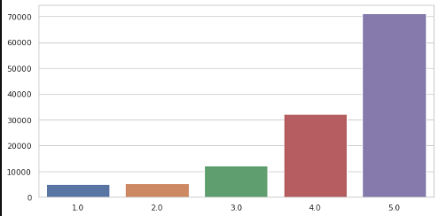
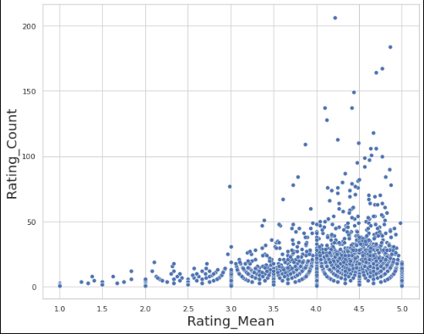
Exploring the data
Rating Distribution
Rating Count Distribution grouped by Products

Slide 8
Model Summary
Model Name | RMSE
Popular based | 2.50
KNN | 1.0417
SVD | 0.9902

Slide 9

Conclusion
Recommender systems are algorithms aimed at suggesting relevant items to users (items being movies to watch, text to read, products to buy or anything else depending on industries). Recommender systems are really critical in some industries as they can generate a huge amount of income when they are efficient or also be a way to stand out significantly from competitors.
We have used 2 different types here,
* Popularity Based Recommender System
* Collaborative Filtering Recommender System
Below are the recommended results of same 3 users picked at random for all the models
Popularity Based Recommender System

Slide 10
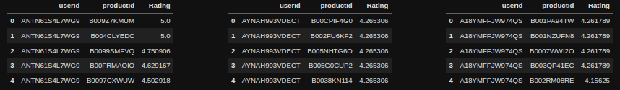
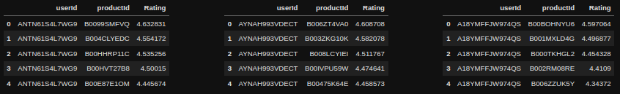
Collaborative Filtering Recommendation Model
KNN with Mean Model Result
SVD Model Result
SVD is better model compared to KNN or Popularity with a better RMSE value of 0.981. We can also see the products that are recommended in SVD is different to that of KNNWithMeans as SVD uses matrix factorization. This is more useful when the data is sparse with many missing ratings.

